Slide 1


National Association of Student
Financial Aid Administrators
Federal Update
Megan Coval
COSUAA
April 2019

Slide 2
Agenda
Inside the Beltway
Outlook
  Higher Education Act Reauthorization
    House
    Senate
    FAFSA Act
  Federal Budget & Funding
Department of Education Update
NASFAA Update

Slide 3
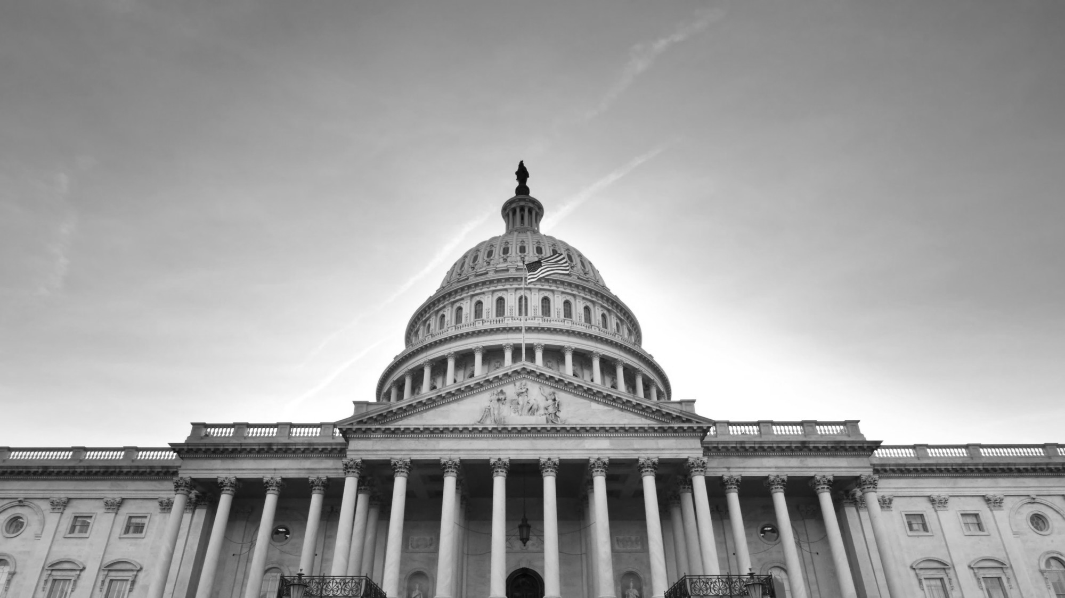
Inside the Beltway

Slide 4
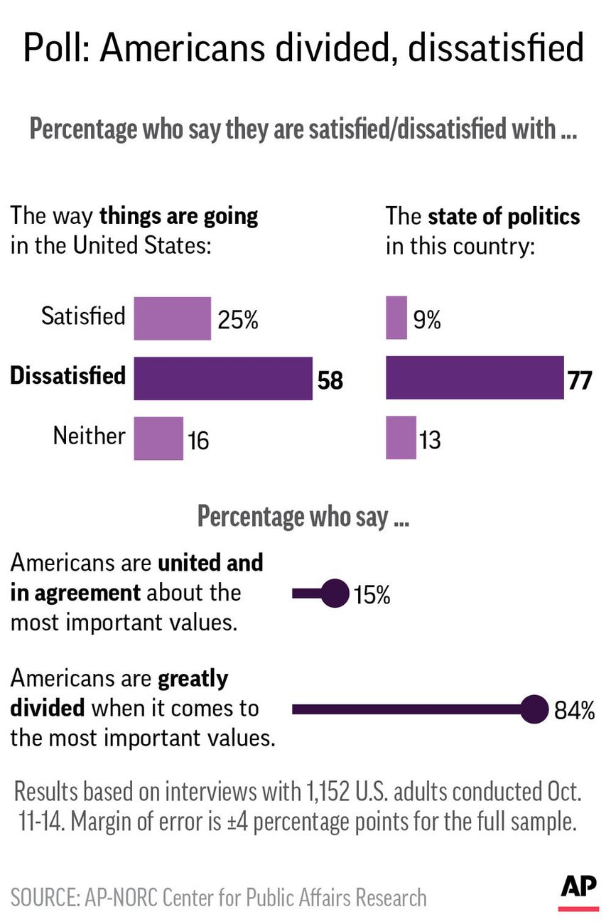

Dynamics in Washington—The Nation is Dissatisfied

Slide 5
Dynamics in Washington- The Nation is Tired
The takeaway: ”14% of America, roughly half left and half right, consistently shouts, posts and votes, while 67% of us are exhausted.”
Source: "Hidden Tribes: A Study of America’s Polarized Landscape."
Source: Axios AM’s Mike Allen

Slide 6
2018 Midterm Results
U.S. House of Representatives
235 Dems
218 to majority
U.S. Senate
47 Dems
GOP 53
51 to majority

Slide 7
Dynamics in Washington
New committee leadership in the House:
  Committee on Education and the Workforce
    Chairman: Rep. Bobby Scott (D-VA)
  Committee on Appropriations
    Chairwoman: Rep. Nita Lowey (D-NY)
Democratic House majority will likely mean increased oversight of ED
Feasibility of a bipartisan HEA reauthorization remains unclear

Slide 8
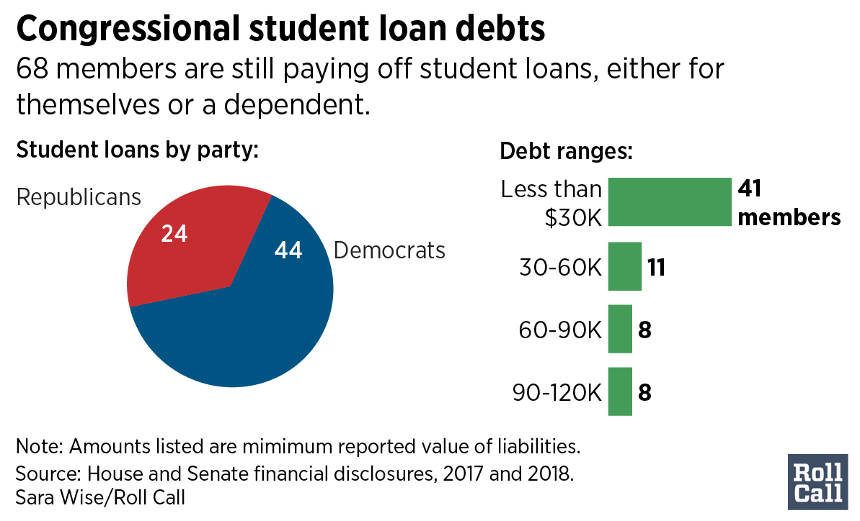

Slide 9
One Area of Agreement?
Distrust/Disillusion with traditional Higher Education
  Unaffordable
  Unattainable
  Only for elite
  Not as necessary as we think it is
Things that don’t help:
  Main stream media focus on college cost and indebtedness
  School closures
  Scrutiny over race in admissions
  Varsity Blues scandal

Slide 10
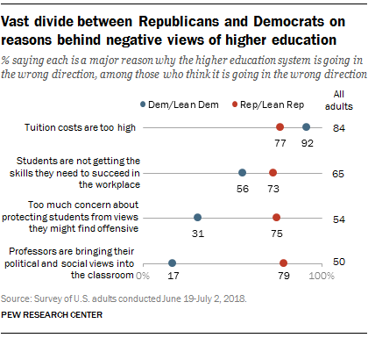
Divide between Republicans & Democrats

Slide 11
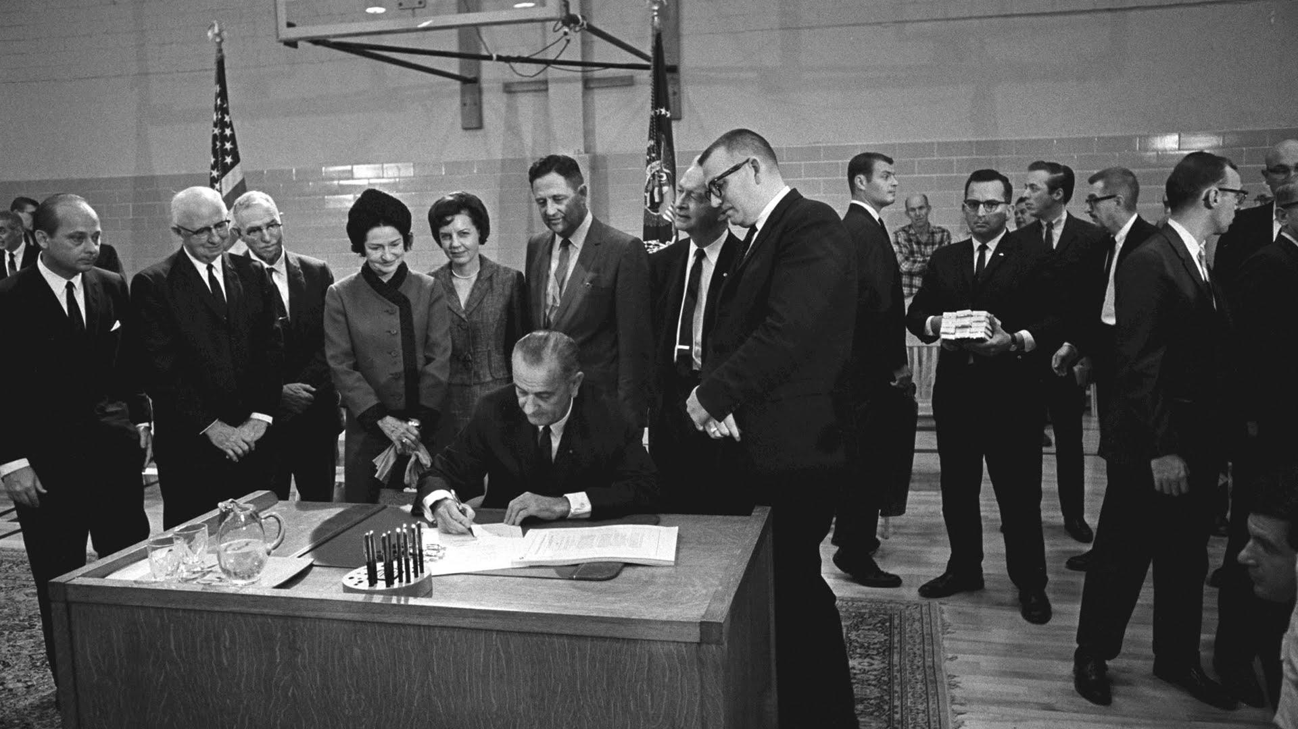
HEA Reauthorization

Slide 12
HEA Reauthorization
Last reauthorization in 2008
  Current version of HEA technically expired in 2013
House
  Republicans: Promoting Real Opportunity, Success and Prosperity Through Education Reform (PROSPER) Act
    Passed House education committee in December 2017
  Democrats: Aim Higher Act
    Introduced July 2018
    Starting point for HEA conversations in the House in 2019
Senate
  No comprehensive bills from either side yet, but Sen. Alexander’s pending retirement adds a new dynamic.

Slide 13
House Democrats - Aim Higher Act Overview
Substantially increases federal investment in student aid
  Pell Grant - Increases maximum award by $500; permanently indexes to inflation; increases mandatory funding share to 60%
  Maintains all current programs, increases funding for many of them
Includes positive attempts to streamline
  FAFSA simplification, elimination of origination fees, streamlines repayment options
Maintains and strengthens accountability standards for certain institutions
  Maintains gainful employment provision
  Changes 90/10 rule to 85/15

Slide 14
House Republicans - PROSPER Act Overview
Substantially decreases federal investment in student aid
  Level-funds Pell Grant – does not index to inflation
  Eliminates 7+ major federal student aid programs (including FSEOG, subsidized loans, Grad PLUS, PSLF, TEACH, FWS eligibility for grad students, etc.)
Includes positive attempts to streamline
  FAFSA simplification, elimination of origination fees, institutional authority to limit loans, FSA reform and accountability, streamlines repayment options
Alters accountability standards
  Repeals gainful employment, 90/10 rule

Slide 15
Senate Republicans - HEA Priorities
On February 4, Sen. Alexander (R-TN) announced three components of his HEA reauthorization proposal
  FAFSA simplification
      No more than 2...dozen questions
      Pairs with FAFSA Act
  Repayment consolidation and reform
      Automatic income-driven option through payroll withholding
      “Standard” option still available, but also through payroll withholding
  Accountability
      Programmatic loan repayment metric

Slide 16
Senate Democrats - HEA Priorities
Affordability and student debt
Addressing state disinvestment
Access and success
Strengthening campus-based aid
Accountability and transparency
Outcomes and data
Commitment to Pell
Debt relief/refinancing
Loan servicing
Serving underrepresented students
Policies for "today's student"
Accreditation reform
Increased accountability for for-profit schools
Protecting student safety and rights
Campus sexual assault
LGBTQ students
Students with disabilities
Hazing
Source: “Senate Democratic Caucus HEA Reauthorization Principles” – Feb. 2018

Slide 17
HEA Issue Priorities
Issue | House Republicans | House Democrats | Senate Republicans | Senate Democrats
“One Grant, One Loan” | ✓ |  | ✓
FAFSA simplification | ✓ | ✓ | ✓ | ✓
Risk-sharing | ✓ | ✓ | ✓ | ✓
Repayment simplification | ✓ | ✓ | ✓ | ✓
Free college for two years |  | ✓ |  | ✓
Pell Grant increases tied to inflation |  | ✓ |  | ✓
Pell Grants for short-term programs | ✓ | ✓ | ✓ | ✓
Pell Grant “bonus” for increased credit load | ✓ |  |  | ✓
Eliminate origination fees | ✓ | ✓ |  | ✓
Loan refinancing |  | ✓ |  | ✓
Campus-based aid allocation formula changes | ✓ | ✓ |  | ✓

Slide 18
HEA Reauthorization: Last Session
 | PROSPER | Aim Higher
1. Introduce in the House | ✓ | ✓
2. House Committee mark-up | ✓
3. Pass out of Committee | ✓
4. Pass out of full House
5. Senate introduces comprehensive bill
6. Senate Committee mark-up
7. Pass out of Committee
8. Pass out of full Senate
9. Conference House & Senate bills
10. Both chambers pass final version
11. President signs into law

Slide 19
Annual Counseling Provisions
The Empowering Students Through Enhanced Financial Counseling Act passed the full House in September 2018 by a vote of 406-4
  Previously passed the full House in 2014 (by a vote of 405-11) and in 2016 (by voice vote). The Senate has not considered the bill in any session.
  Bipartisan support indicates annual counseling may be an HEA priority.
The bill would require:
  All Pell recipients and Direct Loan borrowers (including Parent PLUS), to receive annual counseling before disbursement
  All borrowers to accept loans annually by signing a master promissory note (MPN) or written statement
  Institutions to provide new exit counseling information

Slide 20
FAFSA Act
Bipartisan Faster Access to Federal Student Aid (FAFSA) Act, introduced in the Senate in November 2018
  Allows for direct cross-agency sharing between IRS and ED
    All items currently brought over from the DRT
    Applicant’s filing status
  Addresses burden associated with verification, including verification of non-filing
  Permits ED, with applicant’s consent, to share tax return information related to the application, award, and administration of aid with allowable entities (institutions of higher education, state grant agencies, etc.)
  Permits sharing of taxpayer information between ED and IRS related to IDR and TPD

Slide 21
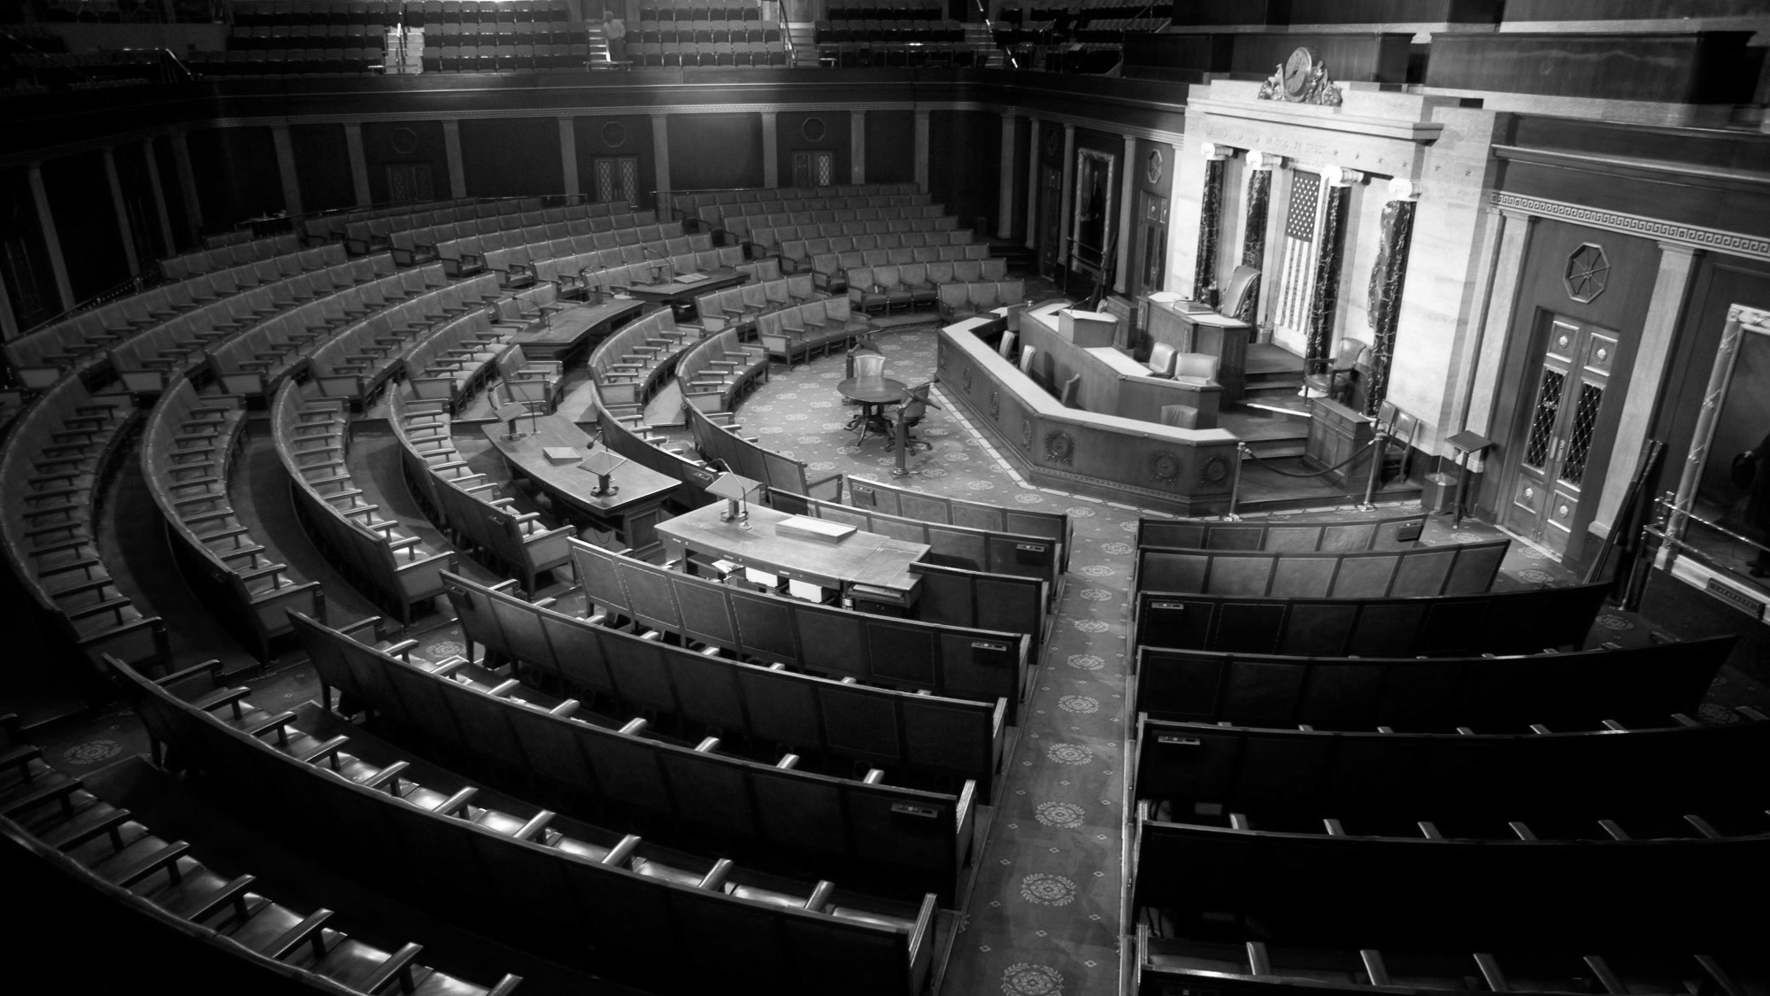
Federal Budget & Funding

Slide 22
FY 2019 Appropriations Update
House and Senate leaders agreed on funding levels for FY 2019 defense, labor, health, and education programs in September 2018
President Trump signed the package into law on September 28
First “regular order,” on-time passage of education funding in over two decades (since 1996)

Slide 23
FY 2019 Appropriations Package
Funding Provisions:
Additional Provisions:
Expanded FAFSA data-sharing
Deferment for Active Cancer Treatment Act
ED allowed to use Student Aid Administration funds to support Perkins Loan servicing (though unlikely)
ED required to include and evaluate multiple servicers in “NextGen Financial Services Environment”
Pell Grant
Increases maximum Pell Grant award by $100 to $6,195 (funded in part by a $600 million rescission from reserves)
Federal Supplemental Educational Opportunity Grant (FSEOG)
Level-funded at $840 million
Federal Work Study (FWS)
Level-funded at $1.1 billion
Public Service Loan Forgiveness (PSLF)
$350 million for borrowers who were enrolled in ineligible repayment plans – first come, first served account - $700 million total over 2 years

Slide 24

FY 2019 President’s Budget vs. Passed Bill
Trump Budget Proposal | Final Appropriations Bill
Flat-lines Pell maximum award | Increases Pell maximum award by $100
N/A | Cuts $600 million from Pell reserves
Eliminates FSEOG | Level-funds FSEOG
Cuts FWS by $500 million; limits eligibility to undergraduates | Level-funds FWS
Eliminates in-school interest subsidy, PSLF | Additional $350 million for borrowers enrolled in ineligible PSLF plans

Slide 25
FY 2020 President’s Budget
Slide 25 © 2019 NASFAA
Funding Provisions:
Additional Provisions:
Support for student loan risk-sharing
Support for expansion of Pell Grants to short-term programs
Revise FWS formula
Eliminates FWS eligibility for graduate students
IDR consolidation
  12.5% discretionary income
    Undergrads: 15 years
    Grad/prof: 30 years
Pell Grant
No increase to maximum Pell Grant award ($6,195), but $2 billion cut to Pell reserves
Federal Supplemental Educational Opportunity Grant (FSEOG)
Eliminated
Federal Work Study (FWS)
Cut by $630 million to $500 million
Public Service Loan Forgiveness (PSLF)
Eliminated
Subsidized Loans
Eliminated
Student Aid Administration
Increase of $134 million to support NextGen

Slide 26
What’s next for FY 2020?
Dramatic cuts to student aid in President’s budget again this year, but as always, Congress has the final say.
NASFAA will continue to advocate with the community to raise the spending caps and for robust investment in the federal student aid programs.
Just yesterday/today:
  House Labor HHS Appropriations Subcommittee released text of their FY2020 bill and will mark-up today:
    Max Pell $6,345 ($150 increase)
    SEOG $1 billion (+$188 million)
    FWS $1.4 billion (+$304 million)
  Next stop, Senate, but good starting place!

Slide 27
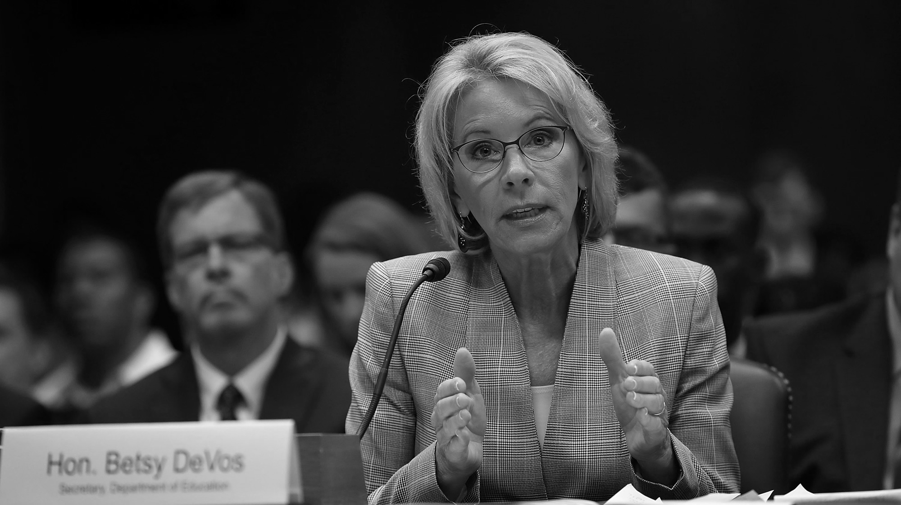
Department of Education

Slide 28
Negotiated Rulemaking: January – April 2019
Addressed rules regarding:
  Accreditation & Innovation
  Distance Learning (sub-committee)
  TEACH Grants (sub-committee)
  Faith-based Entities (sub-committee)
Committee reached consensus on proposed regulatory language
ED expected to publish NPRMs in late Spring/early Summer for public comment
Final rules must be published by November 1, 2019 to be effective for the 2020-2021 award year

Slide 29
Verification Guidance Updates
New acceptable documentation for verification
  Signed copy of income tax return
  Signed statement of Verification of non-filling
  Signed copy of form1040x for amended filers
Applies to 2018-2019 & 2019-2020 award years
ED Shopping Sheet
Released beta version of the new 2019-20 Financial Aid Shopping Sheet
  Soliciting input from institutions to inform the creation of the final version
    To be released for 2020-21 award year

Slide 30
ED EA on Aid Offers
Released last week
Items to “avoid”
Community not consulted
Some conflicts with CFP

Slide 31
White House Executive Order
Slide 31 © 2019 NASFAA
New College Scorecard Components
Introduction of program-level data:
  Estimated median earnings;
  Median Direct subsidized and unsubsidized loan debt;
  Median Graduate PLUS loan debt (if applicable);
  Median Parent PLUS loan debt (if applicable); and
  Student loan default and repayment rates.
Expanded institution-level data:
  Student loan default and repayment rates;
  Graduate PLUS default and repayment rates; and
  Parent PLUS default and repayment rates.
On March 21, the Trump Administration issued its first higher education executive order with two components (to be implemented by Jan. 1, 2020):
  “Improving Free Inquiry on Campus”
      Requires heads of several federal agencies to "ensure institutions that receive federal research and education grants promote free inquiry"
      Specifically excludes "federal student aid programs that cover tuition, fees, or stipends”
  “Improving Transparency and Accountability on Campus”
      Introduces program-level data on College Scorecard
      Expands institution-level data on College Scorecard

Slide 32
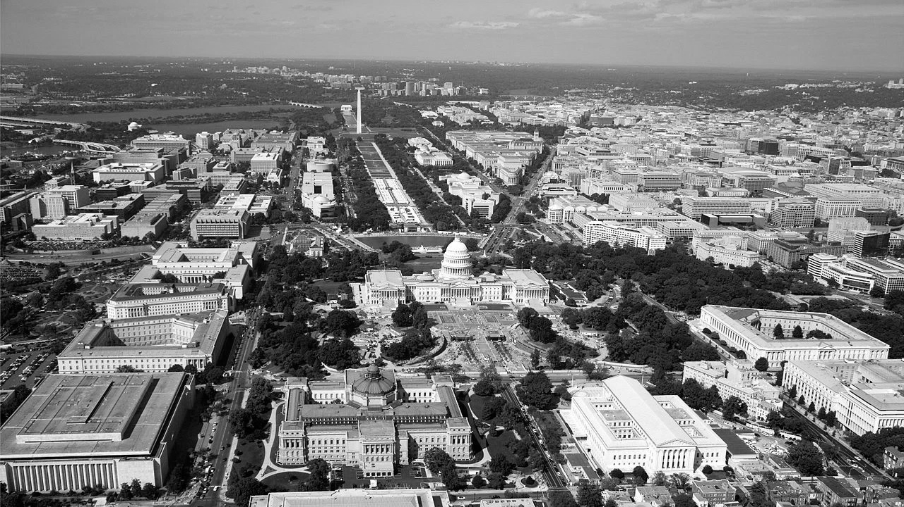
NASFAA Update

Slide 33
NASFAA’s Recent Work on Award Notifications
In June 2018, the NASFAA Board of Directors voted to endorse a recommendation to Congress to standardize terms and elements on award notifications
  Recommendation would incorporate NASFAA Code of Conduct into statute
For more information:
  nasfaa.org/Improving_Award_Notifications

Slide 34
NASFAA’s Recent Work on Award Notifications
NASFAA has identified four elements that belong in an award notification:
  Breakdown of estimated individual COA components, including which are direct (billed) costs vs. indirect (non-billed) costs;
  Clear identification and proper grouping of each type of award, indicating whether the aid is a grant/scholarship, loan, or work program;
  Estimated net cost; and
  Standard terminology, including for example, common definitions for net price/cost.

Slide 35



Advocacy Opportunities
Volunteer!
Work with and support NASFAA:
Write and Visit Your Member of Congress
Share your advocacy efforts with NASFAA, so we can support and assist you
New education committee members mean new states in the mix!
nasfaa.org/volunteer_information
Advocacy Pipeline and Advocacy Network
Policy Task Forces
Get Students Involved!
Stay Informed
Read NASFAA’s Today’s News and Policy and Advocacy Webpages on nasfaa.org

